Slide 1
Error Checking for Sparse Systolic Tensor Arrays
Christodoulos Peltekis, Dionysios Filippas, Giorgos Dimitrakopoulos
Electrical and Computer Engineering
Democritus University of Thrace, Greece
2024 IEEE International Conference on Artificial Intelligence Circuits and Systems

Slide 2
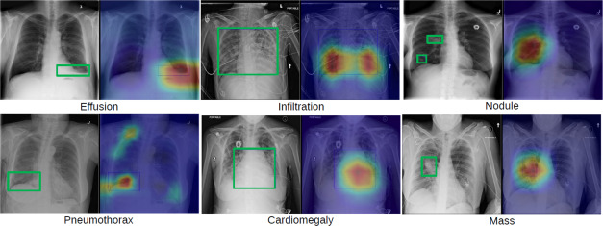
Safety Critical Machine Learning Applications
Medical Imaging
Autonomous Driving
Security
Industrial Automation
Christodoulos Peltekis - Integrated Circuits Lab @ DUTh

Slide 3
Weight pruning for model-size reduction
A simple way to reduce neural network’s size is weight pruning
The less important weights are removed
Easier to fit in edge devices with limited resources
Pruning results in sparse weights
Reduce the number of required computations
Significantly improve inference speed
Allow for lower computation cost during training
To further reduce model size → combined with other compression techniques
Christodoulos Peltekis - Integrated Circuits Lab @ DUTh

Slide 4
Structured Block Sparsity
N:M structured block sparsity
Up to N non-zero elements out of M
M is small in practice
Indexing in each block → bit masks
Sparsification needs retraining/fine tuning for acceptable accuracy
e
w
4
a
x
b
f
c
y
g
d
z
h
compress
values
bit_mask
w
0110
1001
1100
2
a
e
b
f
x
c
g
y
1010
0101
1010
d
h
z
Christodoulos Peltekis - Integrated Circuits Lab @ DUTh

Slide 5
Sparse Systolic Tensor Arrays
Tensor Processing Element
Tensor Processing Element
Consists of TPEs instead of scalar PEs
TPE stores only the non-zero weights
TPE
TPE
TPE
W
TPE
a
A
4
c
b
a
c
a
b
c
d
e
f
g
h
d
i
j
k
l
m
n
o
p
g
b
d
q
r
s
t
u
v
w
x
e
TPE
TPE
TPE
TPE
h
f
e
g
f
h
Christodoulos Peltekis - Integrated Circuits Lab @ DUTh

Slide 6
Sparse Systolic Tensor Arrays
Tensor Processing Element
A block of inputs flow through each row of the systolic
Index of each weight selects the corresponding input to be multiplied
Could be configured for either 2:4 or 1:4 block sparsity
q
i
a
TPE
TPE
r
j
b
s
k
c
0
1
t
l
d
a
2
3
a
c
c
b
d
u
m
e
TPE
TPE
v
n
f
w
o
g
1
0
x
p
h
3
2
e
g
f
h
Christodoulos Peltekis - Integrated Circuits Lab @ DUTh

Slide 7
Sparse Systolic Tensor Arrays
Tensor Processing Element
A block of inputs flow through each row of the systolic
Index of each weight selects the corresponding input to be multiplied
Could be configured for either 2:4 or 1:4 block sparsity
q
i
TPE
TPE
r
j
s
k
0
1
t
l
i
2
b
3
a
k
c
d
b
d
u
m
e
TPE
TPE
v
n
f
w
o
g
1
0
x
p
h
f
3
2
e
h
g
f
h
Christodoulos Peltekis - Integrated Circuits Lab @ DUTh

Slide 8
Sparse Systolic Tensor Arrays
Tensor Processing Element
A block of inputs flow through each row of the systolic
Index of each weight selects the corresponding input to be multiplied
Could be configured for either 2:4 or 1:4 block sparsity
q
TPE
TPE
r
s
0
1
t
q
2
j
3
a
s
c
l
b
d
u
m
TPE
TPE
v
n
w
o
1
0
x
p
n
3
e
2
e
p
g
g
f
h
Christodoulos Peltekis - Integrated Circuits Lab @ DUTh

Slide 9
Sparse Systolic Tensor Arrays
Tensor Processing Element
A block of inputs flow through each row of the systolic
Index of each weight selects the corresponding input to be multiplied
Could be configured for either 2:4 or 1:4 block sparsity
TPE
TPE
0
1
r
2
3
a
c
t
b
d
u
TPE
TPE
v
w
1
0
x
v
3
m
2
e
x
g
o
f
h
Christodoulos Peltekis - Integrated Circuits Lab @ DUTh

Slide 10
Sparse Systolic Tensor Arrays
Tensor Processing Element
A block of inputs flow through each row of the systolic
Index of each weight selects the corresponding input to be multiplied
Could be configured for either 2:4 or 1:4 block sparsity
TPE
TPE
0
1
2
3
a
c
b
d
TPE
TPE
1
0
u
3
2
e
g
w
f
h
Christodoulos Peltekis - Integrated Circuits Lab @ DUTh

Slide 11
Algorithmic-Based Fault Tolerance
Per-row checksum vector
A
W
C
3
5
2
2
4
3
1
8
36
33
22
4
1
4
3
2
4
1
7
42
23
31
2
5
1
2
3
1
5
9
29
29
16
Per-column checksum vector
1
4
2
5
4
1
2
7
38
26
25
Actual checksum
10
15
9
12
Dot product of checksum vectors
350
8
Predicted checksum
7
10
15
9
12
350
9
7
Christodoulos Peltekis - Integrated Circuits Lab @ DUTh

Slide 12
Equivalent Algorithmic-Based Fault Tolerance
Reuse matrix W → Reuse weight stationary hardware
A
W
3
5
2
2
4
3
1
36
33
22
4
1
4
3
2
4
1
42
23
31
2
5
1
2
3
1
5
29
29
16
1
4
2
5
4
1
2
38
26
25
10
15
9
12
To predict checksum multiply
per-column checksum vector with W
4
3
1
Per-column checksum vector
2
4
1
10
15
9
12
145
111
94
Predicted checksum
3
1
5
4
1
2
350
Christodoulos Peltekis - Integrated Circuits Lab @ DUTh

Slide 13
Online ABFT on Sparse Systolic Tensor Arrays
Add IC and OC modules in the periphery of the sparse tensor array to implement ABFT
Per-column checksum vector accumulated in ICs and then fed to the SA
Predicted checksum computed in OC modules
0: Normal
1: Checksum
IC
TPE
TPE
IC
mode
0
1
IC
TPE
TPE
0
1
0
1
OC
OC
0
1
actual
checksum
predicted
checksum
mode
Christodoulos Peltekis - Integrated Circuits Lab @ DUTh

Slide 14
Increasing Width of Accumulators
How to fit 16-bit accumulator value to the 8-bit datapath?
IC
IC accumulators accumulate multiple rows of A →larger than input width
TPEs follow input values’ bit-width
Per-column checksum values accumulated in ICs could not fit in utilized MAC units
8
8
0
1
16
8
0
TPE
1
8
16
…
8
8
0
1
W₀
16
8
8
W₁
0
1
16
…
Accumulate multiple input values
Christodoulos Peltekis - Integrated Circuits Lab @ DUTh

Slide 15
Increasing Width of Accumulators
IC
IC accumulators accumulate multiple rows of A →larger than input width
TPEs follow input values’ bit-width
Per-column checksum values accumulated in ICs could not fit in utilized MAC units
0
1
0
TPE
1
…
0
1
W₀
0
W₁
1
…
Breakdown per-column checksum values to digits → equal size with input values
Christodoulos Peltekis - Integrated Circuits Lab @ DUTh

Slide 16
Experimental Setup
IC
mode
Assume that faults may occur in storage elements
Faults may occur in both sparse tensor array and checking logic
Probability of error is proportional to the number and size of storage elements
…
…
0
TPE
TPE
1
IC
0
1
W₀
W₀
W₁
W₁
0
1
0
OC
OC
1
actual
checksum
predicted
checksum
mode
Christodoulos Peltekis - Integrated Circuits Lab @ DUTh

Slide 17
Fault Detection Properties
# of Faults | 1 fault |  | 1 – 5 faults
Block Sparsity | 2:4 | 1:4 | 2:4 | 1:4
Detected | 81.11% | 74.15% | 95.61% | 93.34%
Silent | 12.46% | 20.75% | 2.15% | 4.95%
False Positive | 2.36% | 2.58% | 0.58% | 0.69%
False Negative | 4.07% | 2.51% | 1.65% | 1.02%
Performed 15000 independent fault-injection campaigns
Four possible scenarios of fault campaigns:
Detected: An error occurred, and the checker detect it
Silent: The fault was masked although the checker remained fault free
False Positive: The checker flagged a fault detection, but no fault occurred
False Negative: An error occurred, but the checker did not detect it
Christodoulos Peltekis - Integrated Circuits Lab @ DUTh

Slide 18
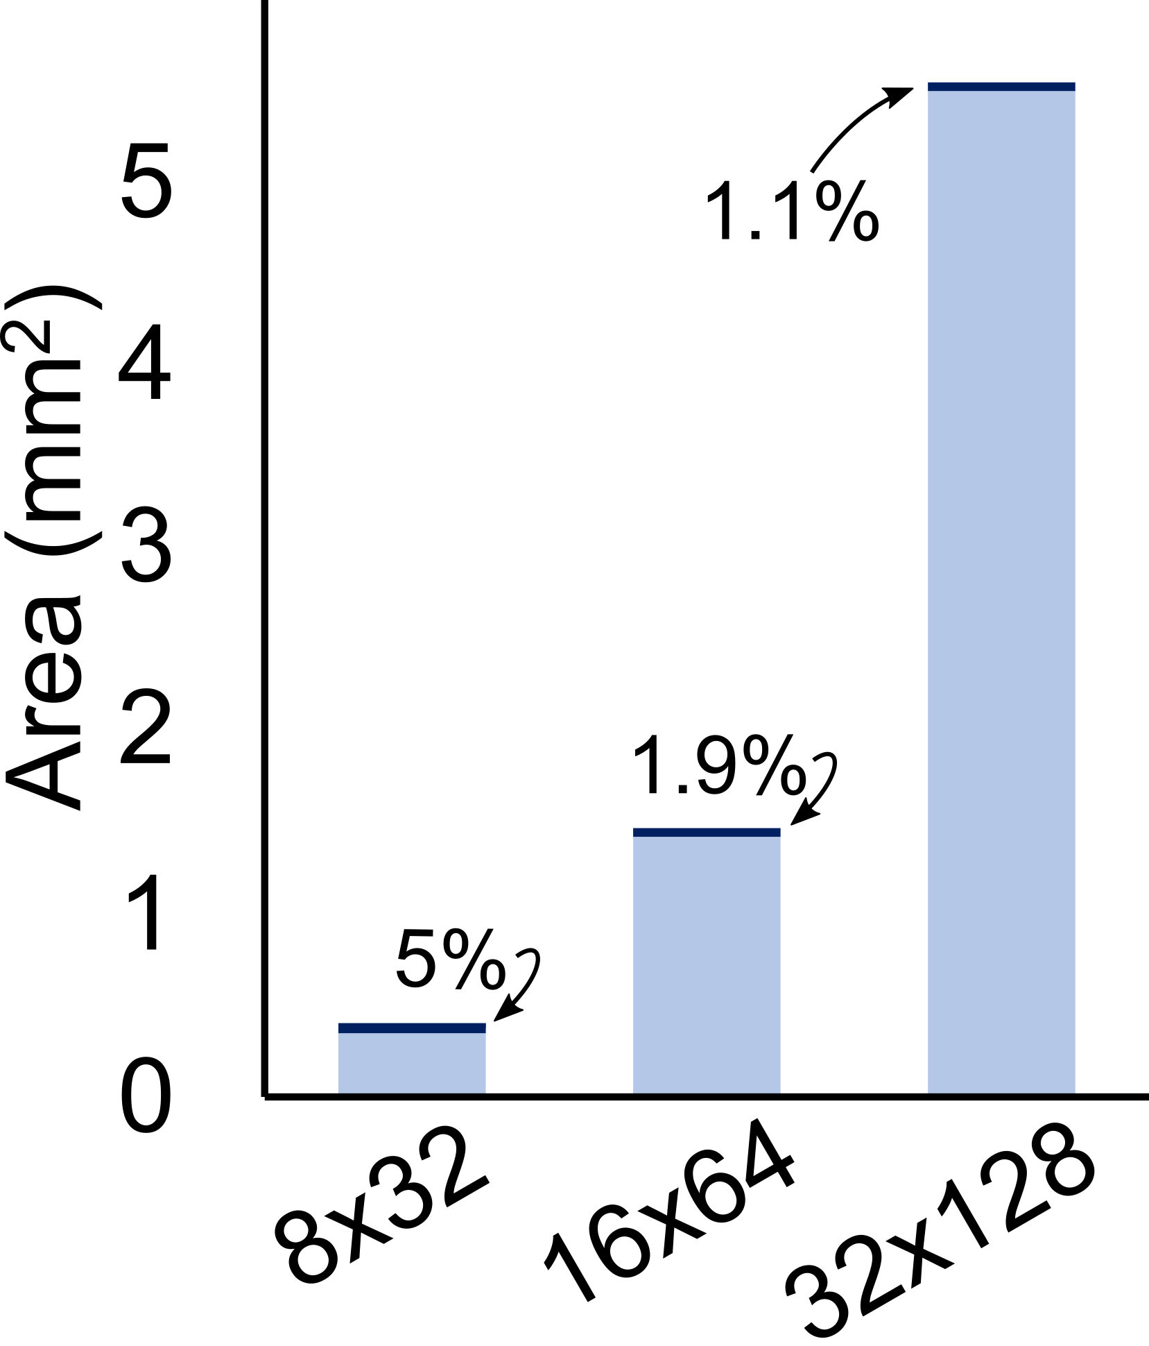
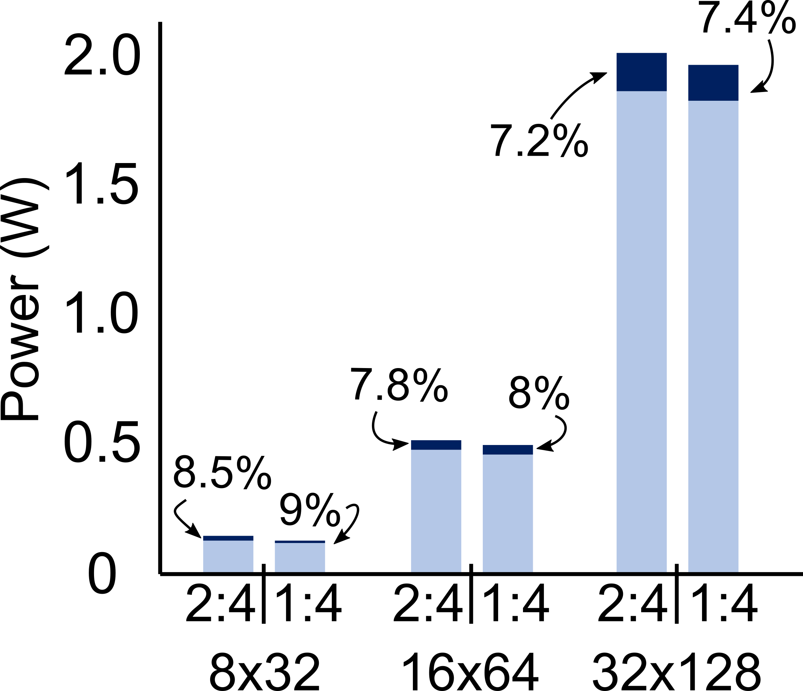
Hardware Overhead
Inputs and weights are 8-bit quantized integers
Area overhead reduced with the size of the sparse tensor array
Sparser weights → lower power consumption in each TPE
Power consumption in ICs and OCs independent of sparsity
Greater power overhead for 1:4 block sparsity
Christodoulos Peltekis - Integrated Circuits Lab @ DUTh

Slide 19
Conclusions
Adapt the widely accepted ABFT methodology for online error checking to the unique characteristics of sparse systolic tensor arrays
The low-cost checking logic is placed on the west and south end of the sparse systolic tensor array and reuses its computation units to predict the checksum
Checksum computation performed in a digit-serial manner to fit in the available hardware
Fault detection properties validated by the rich fault-injection campaigns
Christodoulos Peltekis - Integrated Circuits Lab @ DUTh

